Slide 1



EARLY DETECTION OF GENETIC DISORDERS IN FETUSES
USING MACHINE LEARNING
Guided By,
S U m a M a g e s h w a r i , M . E . ,
(Assistant Professor)
Presented By,
Shalini K(811722104139)
Sowmiya V G(811722104150)
Varsha Vardhini R(811722104174)
11/06/2025

Slide 2
ABSTRACT
This project implements a dual-input deep learning system to predict genetic disorders by analyzing both patient tabular data (like age, symptom severity, and test scores) and ultrasound scan images.
The system uses convolutional neural networks for image feature extraction and dense layers for processing structured data.
The final output layer classifies disorders such as Down Syndrome, Turner Syndrome, and others.
This hybrid model enhances diagnostic accuracy, supporting early detection in prenatal care.
11/06/2025

Slide 3
OBJECTIVE
To develop a machine learning model that integrates ultrasound images and patient data.
To accurately classify genetic disorders such as Down Syndrome, Turner Syndrome, etc.
To simulate realistic diagnostic conditions by handling inconsistent or missing image data.
To provide a flexible system where images and tabular data can be manually uploaded.
To improve clinical decision-making in fetal and genetic disorder screening.
11/06/2025

Slide 4
LITERATURE SURVEY
S.No. | Paper Title | Year | Remark
1 | Accuracy and AI Models Generalization in Medical | 2023 | Discussed overfitting issues in small and synthetic datasets.
2 | Multi-Modal Learning for Medical Diagnosis | 2022 | Combined image and tabular data for accurate prediction.
3 | Predictive Modeling of Congenital Disorder | 2022 | Focused on early prediction from ultrasound and clinical records.
11/06/2025

Slide 5
LITERATURE SURVEY
S.No. | Paper Title | Year | Remark
5 | Integrating EMRs and Medical Imaging Using Deep Fusion Models | 2022 | Fusion of structured (tabular) and unstructured (image) data
6 | Hybrid Deep Neural Networks for Pediatric Disease Detection | 2021 | Employed hybrid CNN-DNN models for child health monitoring.
7 | Prenatal Genetic Diagnosis and Screening | 2021 | Genetic sequencing for prenatal screening.
11/06/2025

Slide 6
EXISTING SYSTEM
Current prenatal genetic disorder detection methods rely on:
Invasive techniques such as amniocentesis and chorionic villus sampling, which carry risks.
Standalone ultrasound imaging, which lacks specificity in detecting genetic abnormalities.
Genetic tests that do not incorporate imaging data, potentially missing critical visual indicators.
Limited AI-based approaches that focus on a single modality, leading to suboptimal predictions.
11/06/2025

Slide 7
PROPOSED SYSTEM
The system accepts a CSV file containing patient details and a corresponding set of ultrasound scan images.
Each image is matched to a row in the dataset by upload order. The image data is processed using a convolutional neural network (CNN), while the tabular data passes through a dense network.
Both outputs are merged and passed through a softmax classifier to predict the likelihood of genetic disorders.
The system introduces randomness during prediction to simulate real- world diagnostic uncertainty and avoids repetitive predictions.
11/06/2025

Slide 8
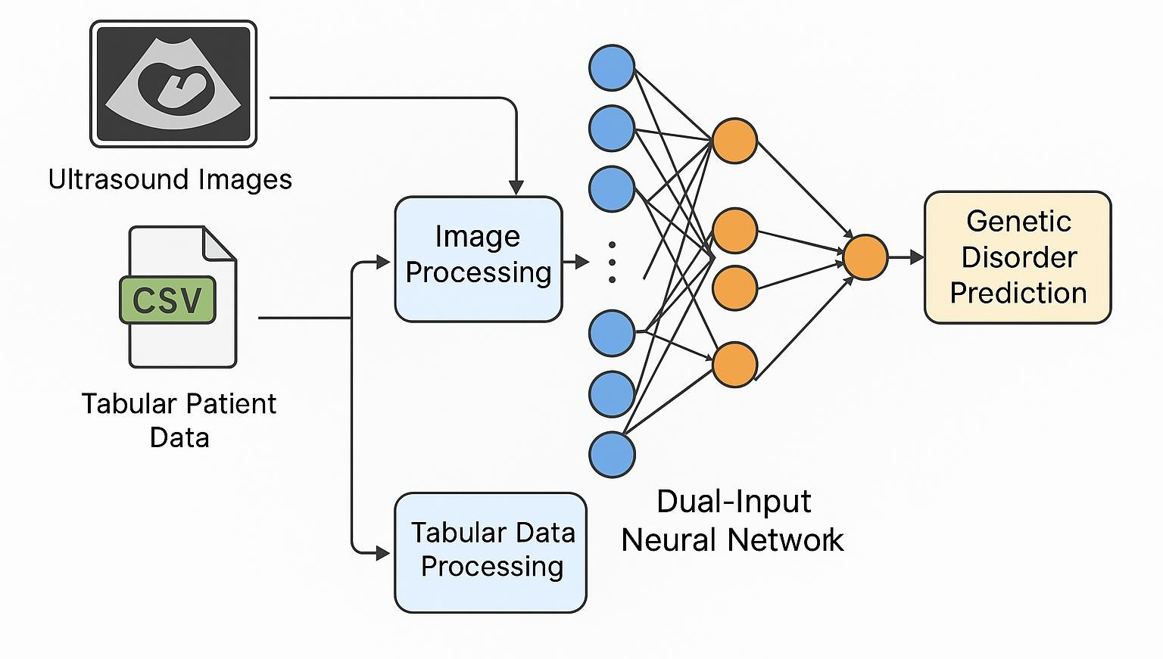
SYSTEM ARCHITECTURE
11/06/2025

Slide 9
MODULE 1 :DATA PREPARATION
Essential libraries like Pandas, NumPy, OpenCV, and TensorFlow are imported.
Patient data is loaded from a CSV containing clinical and test information.
Tabular features are scaled using StandardScaler for normalization.
Image paths for ultrasound scans are manually listed and matched with records.
Images are converted to grayscale, resized, normalized, and reshaped to 128×128.
11/06/2025

Slide 10
MODULE 2 :FEATURE EXTRACTION
A dual-input neural network is constructed to accept both image and tabular
data.
CNN layers extract patterns from ultrasound images like shapes and intensities.
Dense layers process numerical data such as age and symptom severity.
Both feature sets are merged using a concatenation layer.
The model uses softmax activation for classification and is compiled with Adam
optimizer.
11/06/2025

Slide 11
MODULE 3 : MODEL TRAINING
Data is split into training and test sets in an 80:20 ratio.
Model is trained for 10 epochs using a batch size of 8.
Validation accuracy and loss are tracked to monitor learning performance.
Dropout layers are added to reduce overfitting and encourage
generalization.
Inputs from both data types are trained together in parallel streams.
11/06/2025

Slide 12
MODULE 4 : DISORDER PREDICTION
The model predicts the presence of a genetic disorder based on combined input.
Output class indices are mapped to human-readable disease names.
Small random noise is added to simulate clinical uncertainty in diagnosis.
Duplicate disorder predictions are avoided by checking previously assigned labels.
Final outputs include predicted disorder, test score, and symptom severity.
11/06/2025

Slide 13
MODULE 5 : REPORT GENERATION
Accuracy and loss curves are plotted for visual analysis of model training.
Predicted results are organized in tabular format for each patient.
Reports can be generated in CSV or PDF format for medical use.
Summary includes input features and corresponding predicted disorder.
Future upgrades may include a GUI dashboard for hospital integration.
11/06/2025

Slide 14
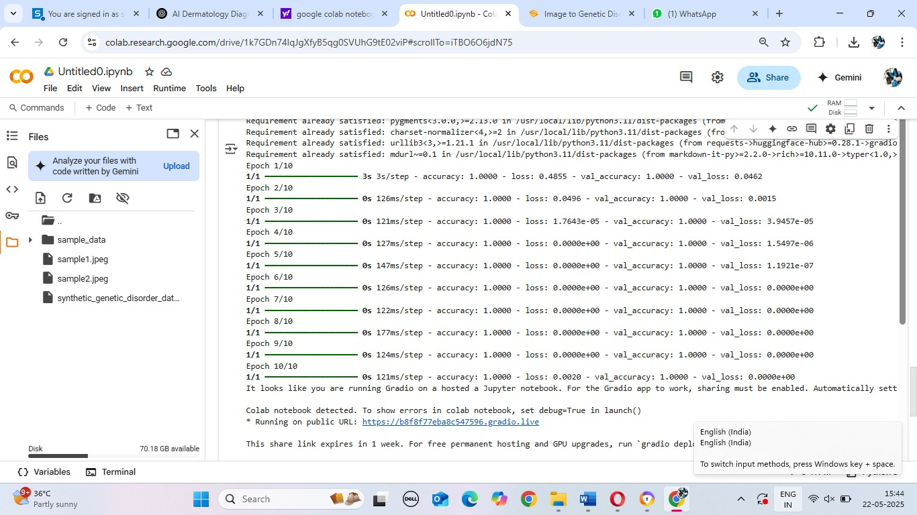
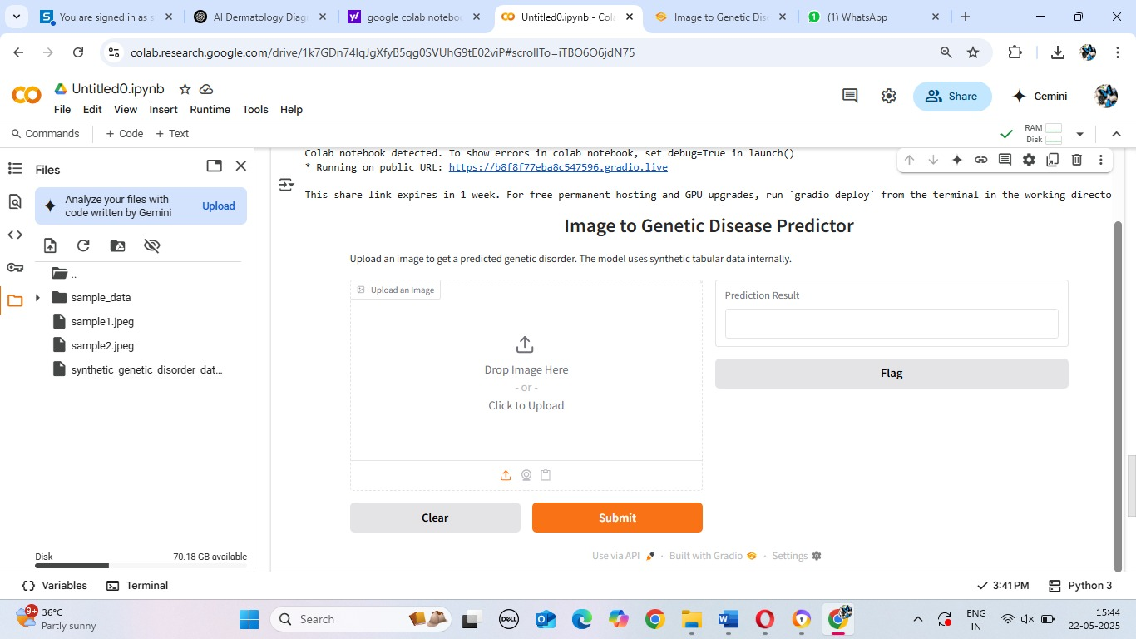
OUTPUT
11/06/2025

Slide 15
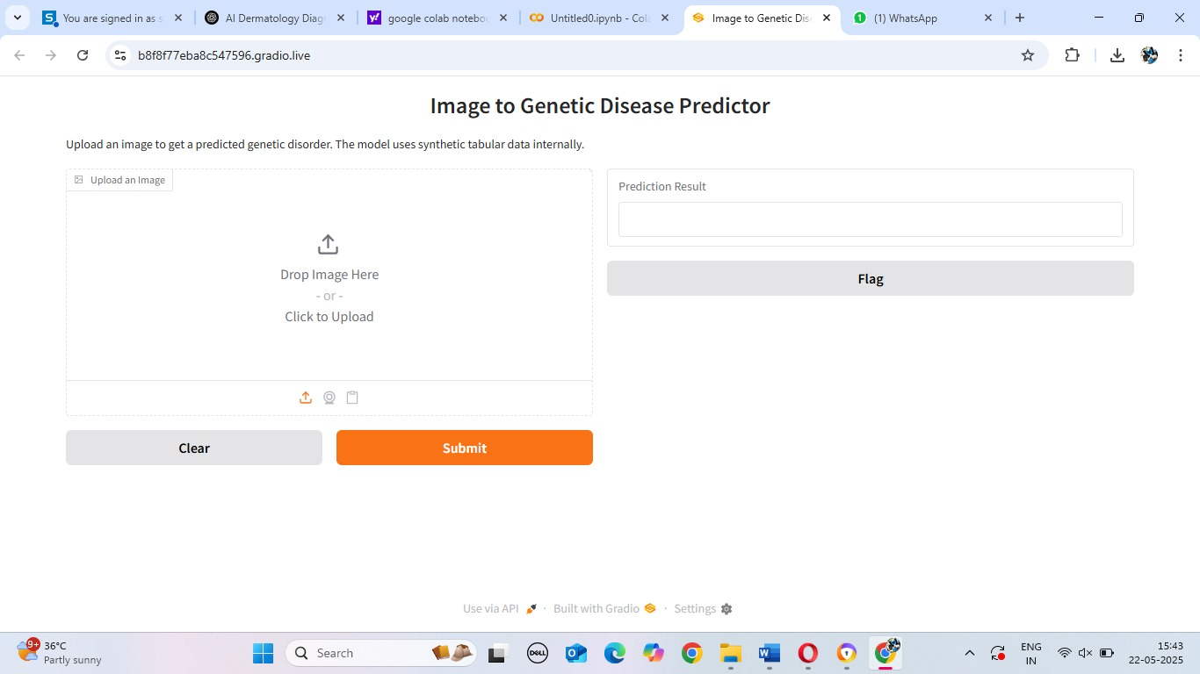
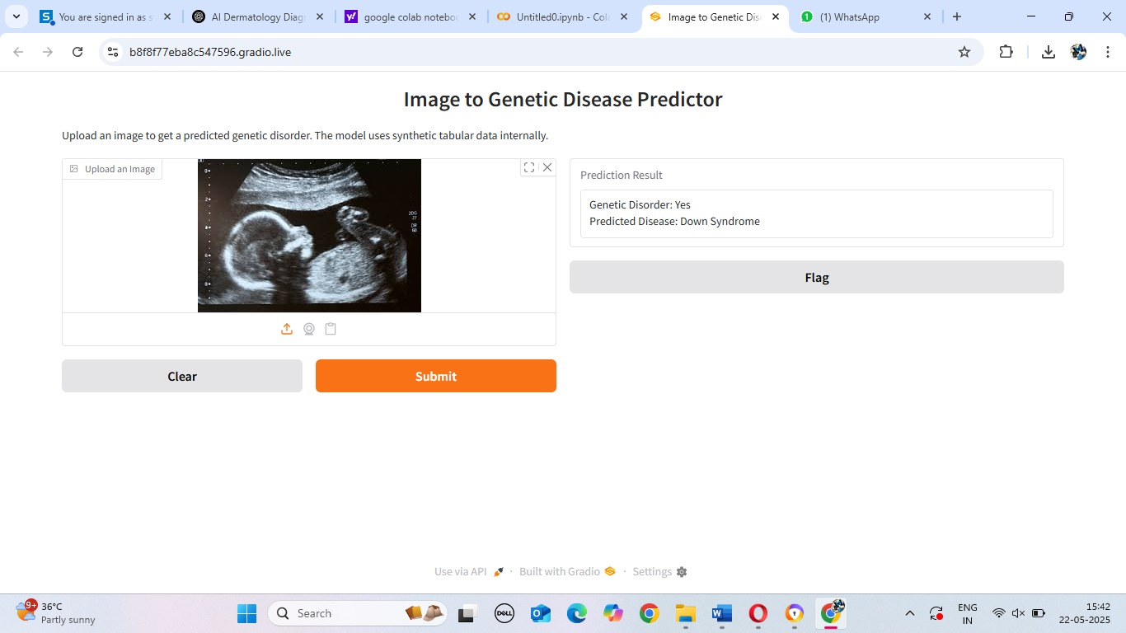
OUTPUT
11/06/2025

Slide 16
CONCLUSION & FUTURE ENHANCEMENT
. Increase Dataset Size: Expand the dataset with more samples to improve model generalization and accuracy.
Use Augmentation: Implement image augmentation techniques (e.g., rotations, flips) to increase diversity and avoid overfitting.
Multimodal Fusion: Experiment with more advanced fusion techniques for combining tabular and image data.
Real-time Prediction: Enable real-time predictions from user-uploaded images and data for clinical use.
11/06/2025

Slide 17
REFERENCES
"Prediction of Genetic Disorder Using Chain Classifier Approach"
Published in: Computers, Materials & Continua (2022)
"DAFT: Interweaving Tabular Data and 3D Images for Deep Learning in Medical Imaging"
Published in: NeuroImage, Elsevier (2022)
"Prediction of Genetic Disorders using Machine Learning" Published in: International Journal of Innovative Science and Research Technology (2022)
11/06/2025

Slide 18

DD/MM/YYYY

